Slide 2
Structure (struct)
struct StructName {
type1 var1;
type2 var2;
.......
}; // need to terminate by a semi-colon
struct is an intermediate step towards Object-oriented Programming (OOP).
In OOP, we use class that is an user-defined structure containing both data members and member functions.

Slide 3
/* Testing struct */
#include <iostream>
using namespace std;
struct Point {
int x;
int y;
};
int main() {
Point p1 = {3, 4}; // declare and init members
cout << "(" << p1.x << "," << p1.y << ")" << endl; // (3,4)
Point p2 = {}; // declare and init numbers to defaults
cout << "(" << p2.x << "," << p2.y << ")" << endl; // (0,0)
p2.x = 7;
p2.y = 8;
cout << "(" << p2.x << "," << p2.y << ")" << endl; // (7,8)
return 0;
}

Slide 4
#include <iostream>/* * Testing struct */
using namespace std;
struct Point {
int x, y;
};
struct Rectangle {
Point topLeft;
Point bottomRight;
};
int main() {
Point p1, p2;
p1.x = 0; // p1 at (0, 3)
p1.y = 3;
p2.x = 4; // p2 at (4, 0)
p2.y = 0;
cout << "p1 at (" << p1.x << "," << p1.y << ")" << endl;
cout << "p2 at (" << p2.x << "," << p2.y << ")" << endl;
Rectangle rect;
rect.topLeft = p1; rect.bottomRight = p2;
cout << "Rectangle top-left at (" << rect.topLeft.x << "," << rect.topLeft.y << ")" << endl;
cout << "Rectangle bottom-right at (" << rect.bottomRight.x << "," << rect.bottomRight.y << ")" << endl;
return 0;
}

Slide 5
Inline Functions
Function call has its overhead (handling the argument, managing function stack, branch and return). For simple and short functions, you may use inline functions to remove the function call overhead. The keyword inline (before the function's return-type) suggest to the compiler to "expand" the function code in place, instead of performing a function call. For example,
#include <iostream>
using namespace std;
inline int max(int n1, int n2) {
return (n1 > n2) ? n1 : n2;
}
int main() {
int i1 = 5, i2 = 6;
cout << max(i1, i2) << endl; // inline request to expand to (i1 > i2) ? i1 : i2
return 0;
}

Slide 6
Inline Function vs. #define Macro
#include <iostream>
using namespace std;
#define SQUARE(x) x*x // Macro with argument
inline int square(int x) { return x*x; } // inline function
int main() {
cout << SQUARE(5) << endl; // expand to 5*5 (25)
int x = 2, y = 3;
cout << SQUARE(x) << endl; // expand to x*x (4)
cout << SQUARE(5+5) << endl; // expand to 5+5*5+5 - wrong answer// Problem with the expansions
cout << square(5+5) << endl; // Okay square(10)
cout << SQUARE(x+y) << endl; // expand to x+y*x+y - wrong answer
cout << square(x+y) << endl; // Okay
// can be fixed using #define SQUARE(x) (x)*(x)
cout << SQUARE(++x) << endl; // expand to ++x*++x (16) - x increment twice
cout << x << endl; // x = 4
cout << square(++y) << endl; // Okay ++y, (y*y) (16)
cout << y << endl; // y =
}
Inline function is preferred over macro expansion

Slide 7
Ellipses (...)
#include <iostream>
#include <cstdarg>
using namespace std;
int sum(int, ...);
int main() {
cout << sum(3, 1, 2, 3) << endl; // 6
cout << sum(5, 1, 2, 3, 4, 5) << endl; // 15
return 0;
}
int sum(int count, ...) {
int sum = 0;
va_list lst; // Declare a va_list// Ellipses are accessed thru a va_list
// Use function va_start to initialize the va_list, // with the list name and the number of parameters.
va_start(lst, count);
for (int i = 0; i < count; ++i) {
// Use function va_arg to read each parameter from va_list, // with the type.
sum += va_arg(lst, int);
}
va_end(lst); // Cleanup the va_list.
return sum;
}

Slide 8
Scope Resolution Operator
The symbol :: is known as scope resolution operator. If a global variable is hidden by a local variable of the same name, you could use the scope resolution operator to retrieve the hidden global variable.
#include <iostream>// TestScopeResolutionOperator.cpp
using namespace std;
int x = 5; // Global variable
int main() {
// A local variable having the Same name as a global variable, // which hides the global variable
float x = 55.5f;
// Local
cout << x << endl;
// Use unary scope resolution operator to retrieve the global variable
cout << ::x << endl;
return 0;
}

Slide 9
Object-Oriented Programming (OOP) in C++
Suppose that you want to assemble your own PC, you go to a hardware store and pick up a motherboard, a processor, some RAMs, a hard disk, a casing, a power supply, and put them together. You turn on the power, and the PC runs. You need not worry whether the motherboard is a 4-layer or 6-layer board, whether the hard disk has 4 or 6 plates; 3 inches or 5 inches in diameter, whether the RAM is made in Japan or Korea, and so on. You simply put the hardware components together and expect the machine to run. Of course, you have to make sure that you have the correct interfaces, i.e., you pick an IDE hard disk rather than a SCSI hard disk, if your motherboard supports only IDE; you have to select RAMs with the correct speed rating, and so on. Nevertheless, it is not difficult to set up a machine from hardware components.
Similarly, a car is assembled from parts and components, such as chassis, doors, engine, wheels, brake, and transmission. The components are reusable, e.g., a wheel can be used in many cars (of the same specifications).
Hardware, such as computers and cars, are assembled from parts, which are reusable components.
How about software? Can you "assemble" a software application by picking a routine here, a routine there, and expect the program to run? The answer is obviously no! Unlike hardware, it is very difficult to "assemble" an application from software components. Since the advent of computer 60 years ago, we have written tons and tons of programs. However, for each new application, we have to re-invent the wheels and write the program from scratch.
Why re-invent the wheels?

Slide 10
Traditional Procedural-Oriented languages
Traditional procedural-oriented languages (such as C and Pascal) suffer some notable drawbacks in creating reusable software components:
The programs are made up of functions. Functions are often not reusable. It is very difficult to copy a function from one program and reuse in another program because the function is likely to reference the headers, global variables and other functions.
In other words, functions are not well-encapsulated as a self-contained reusable unit.
The procedural languages are not suitable of high-level abstraction for solving real life problems. For example, C programs uses constructs such as if-else, for-loop, array, function, pointer, which are low-level and hard to abstract real problems such as a Customer Relationship Management (CRM) system or a computer soccer game.
In brief, the traditional procedural-languages separate the data structures and algorithms of the software entities.

Slide 11
Object-Oriented Programming Languages
The basic unit of OOP is a class, which encapsulates both the static attributes and dynamic behaviors within a "box", and specifies the public interface for using these boxes.
Since the class is well-encapsulated (compared with the function), it is easier to reuse these classes.
In other words, OOP combines the data structures and algorithms of a software entity inside the same box.
OOP languages permit higher level of abstraction for solving real-life problems.
The traditional procedural language (such as C and Pascal) forces you to think in terms of the structure of the computer (e.g. memory bits and bytes, array, decision, loop) rather than thinking in terms of the problem you are trying to solve.
The OOP languages (such as Java, C++, C#) let you think in the problem space, and use software objects to represent and abstract entities of the problem space to solve the problem.

Slide 12
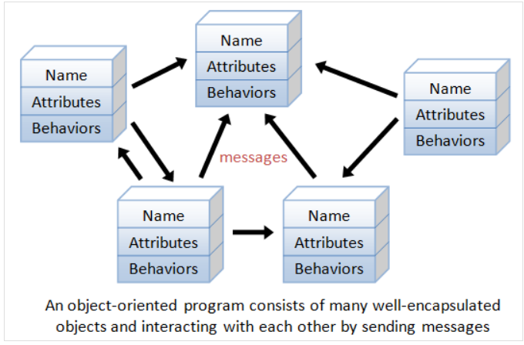

Slide 13
Example:
As an example, suppose you wish to write a computer soccer games. It is quite difficult to model the game in procedural-oriented languages. But using OOP languages, you can easily model the program accordingly to the "real things" appear in the soccer games.
Player: attributes include name, number, location in the field, and etc; operations include run, jump, kick-the-ball, and etc.
Ball:
Reference:
Field:
Audience:
Weather:
Most importantly, some of these classes (such as Ball and Audience) can be reused in another application, e.g., computer basketball game, with little or no modification.

Slide 14
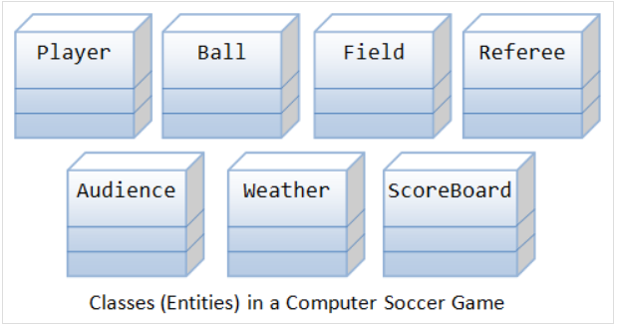

Slide 15
Benefits of OOP
The procedural-oriented languages focus on procedures, with function as the basic unit. You need to first figure out all the functions and then think about how to represent data.
The object-oriented languages focus on components that the user perceives, with objects as the basic unit. You figure out all the objects by putting all the data and operations that describe the user's interaction with the data.
Object-Oriented technology has many benefits:
Ease in software design as you could think in the problem space rather than the machine's bits and bytes. You are dealing with high-level concepts and abstractions. Ease in design leads to more productive software development.
Ease in software maintenance: object-oriented software are easier to understand, therefore easier to test, debug, and maintain.
Reusable software: you don't need to keep re-inventing the wheels and re-write the same functions for different situations. The fastest and safest way of developing a new application is to reuse existing codes - fully tested and proven codes.

Slide 16
Classes & Instances
Class: A class is a definition of objects of the same kind.
In other words, a class is a blueprint, template, or prototype that defines and describes the static attributes and dynamic behaviors common to all objects of the same kind.
Classes also determine the forms of objects. The data and methods contained in a class are known as class members. A class is a user-defined data type. To access the class members, we use an instance of the class. You can see a class as a blueprint for an object.
Instance: An instance is a realization of a particular item of a class.
In other words, an instance is an instantiation of a class. All the instances of a class have similar properties, as described in the class definition. For example, you can define a class called "Student" and create three instances of the class "Student" for "Peter", "Paul" and "Pauline".
The term "object" usually refers to instance. But it is often used quite loosely, which may refer to a class or an instance.

Slide 17
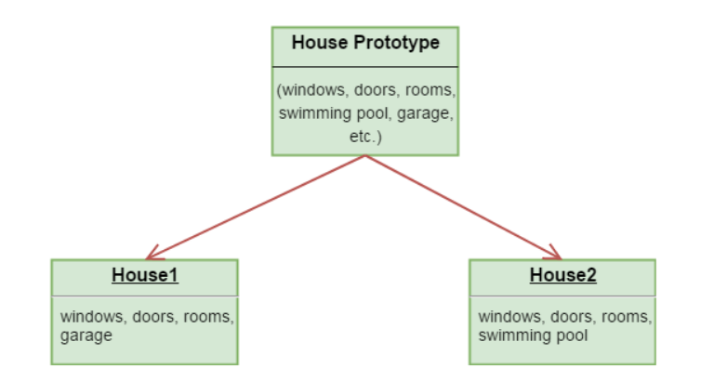
In the above figure, we have a single house prototype. From this prototype, we have created two houses with different features.

Slide 18
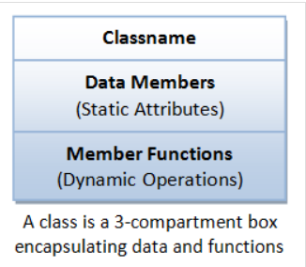
A Class is a 3-Compartment Box encapsulating Data and Functions
A class can be visualized as a three-compartment box, as illustrated:
Classname (or identifier):
identifies the class.
Data Members or Variables (or attributes, states, fields):
contains the static attributes of the class.
Member Functions (or methods, behaviors, operations):
contains the dynamic operations of the class.
In other words, a class encapsulates the static attributes (data) and dynamic behaviors (operations that operate on the data) in a box.
Class Members: The data members and member functions are collectively called class members.

Slide 19
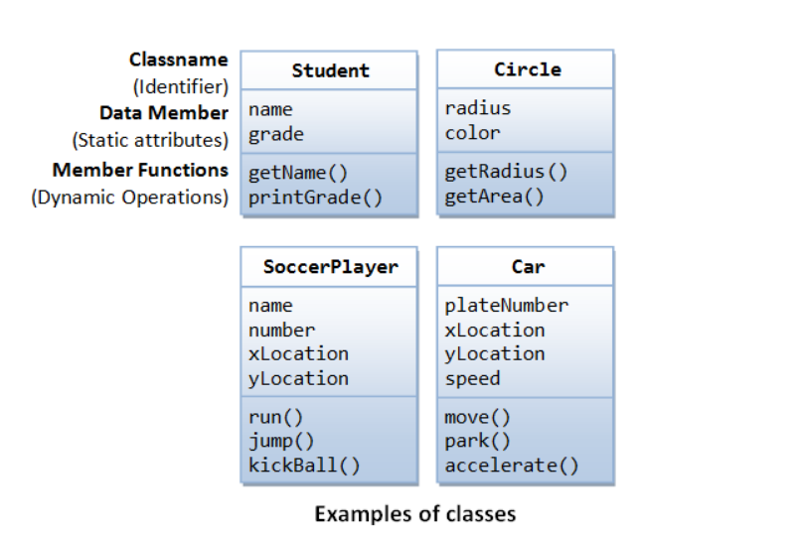
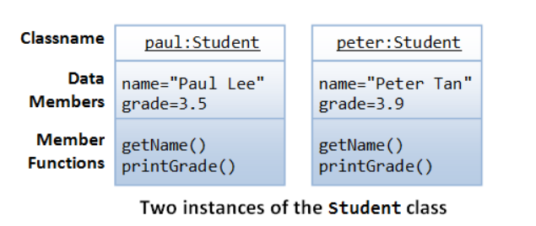
Unified Modeling Language (UML) Class and Instance Diagrams: The class diagrams are drawn according to the UML notations.
A class is represented as a 3-compartment box, containing name, data members (variables), and member functions, respectively. classname is shown in bold and centralized.
An instance (object) is also represented as a 3-compartment box, with instance name shown as instanceName:Classname and underlined.

Slide 20
Class Definition
Class Naming Convention: A classname shall be a noun or a noun phrase made up of several words. All the words shall be initial-capitalized (camel-case).
Use a singular noun for classname. Choose a meaningful and self-descriptive classname.
class Circle { // classname
private:
double radius; // Data members (variables)
string color;
public:
double getRadius(); // Member functions
double getArea();
}
class SoccerPlayer { // classname
private:
int number; // Data members (variables)
string name;
int x, y;
public:
void run(); // Member functions
void kickBall();
}

Slide 21
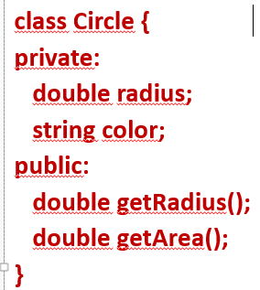
Creating Instances of a Class
To create an instance of a class, you have to:
Declare an instance identifier (name) of a particular class.
Invoke a constructor to construct the instance (i.e., allocate storage for the instance and initialize the variables).
For examples, suppose that we have a class called Circle, we can create instances of Circle as follows:
// Construct 3 instances of the class Circle: c1, c2, and c3
Circle c1(1.2, "red"); // radius, color
Circle c2(3.4); // radius, default color
Circle c3; // default radius and color
Alternatively, you can invoke the constructor explicitly using the following syntax:
Circle c1 = Circle(1.2, "red"); // radius, color
Circle c2 = Circle(3.4); // radius, default color
Circle c3 = Circle(); // default radius and color

Slide 22
Dot (.) Operator
To reference a member of a object (data member or member function), you must:
Use the dot operator (.) to reference the member, instanceName.memberName.
For example, suppose that we have a class called Circle, with two data members (radius and color) and two functions (getRadius() and getArea()).
We have created three instances of the class Circle, namely, c1, c2 and c3.
// Declare and construct instances c1 and c2 of the class Circle
Circle c1(1.2, "blue");
Circle c2(3.4, "green");
// Invoke member function via dot operator
cout << c1.getArea() << endl;
cout << c2.getArea() << endl;
// Reference data members via dot operator
c1.radius = 5.5;
c2.radius = 6.6;

Slide 23
class MyClass { // The class
public: // Access specifier
int myNum; // Attribute (int variable)
string myString; // Attribute (string variable)
};
int main() {
MyClass myObj; // Create an object of MyClass
// Access attributes and set values
myObj.myNum = 15;
myObj.myString = "Some text";
// Print attribute values
cout << myObj.myNum << "\n";
cout << myObj.myString;
return 0;
}

Slide 24
class Car { // Create a Car class with some attributes
public:
string brand;
string model;
int year;
};
int main() {
Car carObj1; // Create an object of Car
carObj1.brand = "BMW";
carObj1.model = "X5";
carObj1.year = 1999;
Car carObj2; // Create another object of Car
carObj2.brand = "Ford";
carObj2.model = "Mustang";
carObj2.year = 1969;
// Print attribute values
cout << carObj1.brand << " " << carObj1.model << " " << carObj1.year << "\n";
cout << carObj2.brand << " " << carObj2.model << " " << carObj2.year << "\n";
return 0;
}

Slide 25
Data Members (Variables)
A data member (variable) has a name (or identifier) and a type; and holds a value of that particular type. A data member can also be an instance of a certain class .
Data Member Naming Convention: A data member name shall be a noun or a noun phrase made up of several words. The first word is in lowercase and the rest of the words are initial-capitalized (camel-case), e.g., fontSize, roomNumber, xMax, yMin and xTopLeft. Take note that variable name begins with an lowercase, while classname begins with an uppercase.
Member Functions
A member function :
receives parameters from the caller,
performs the operations defined in the function body, and
returns a piece of result (or void) to the caller.
Member Function Naming Convention: A function name shall be a verb, or a verb phrase made up of several words. The first word is in lowercase and the rest of the words are initial-capitalized (camel-case). For example, getRadius(), getParameterValues().
Take note that data member name is a noun (denoting a static attribute), while function name is a verb (denoting an action). They have the same naming convention. Functions take arguments in parentheses (possibly zero argument with empty parentheses), but variables do not.

Slide 26
#include <iostream>
using namespace std;
class Geeks {
public:
string geekname;
int id;
void printname(); // printname is not defined inside class definition
// printid is defined inside class definition
void printid() {
cout << "Geek id is: " << id;
}
};
void Geeks::printname() { // Definition of printname using scope resolution operator ::
cout << "Geekname is: " << geekname;
}
int main() {
Geeks obj1;
obj1.geekname = "xyz";
obj1.id=15;
obj1.printname(); // call printname()
cout << endl;
obj1.printid(); // call printid()
return 0;
}

Slide 27
class MyClass { // The class
public: // Access specifier
void myMethod() { // Method/function defined inside the class
cout << "Hello World!";
}
};
int main() {
MyClass myObj; // Create an object of MyClass
myObj.myMethod(); // Call the method
return 0;
}

Slide 28
class MyClass { // The class
public: // Access specifier
void myMethod(); // Method/function declaration
};
// Method/function definition outside the class
void MyClass::myMethod() {
cout << "Hello World!";
}
int main() {
MyClass myObj; // Create an object of MyClass
myObj.myMethod(); // Call the method
return 0;
}

Slide 29
#include <iostream>
using namespace std;
class Car {
public:
int speed(int maxSpeed);
};
int Car::speed(int maxSpeed) {
return maxSpeed;
}
int main() {
Car myObj; // Create an object of Car
cout << myObj.speed(200); // Call the method with an argument
return 0;
}

Slide 30
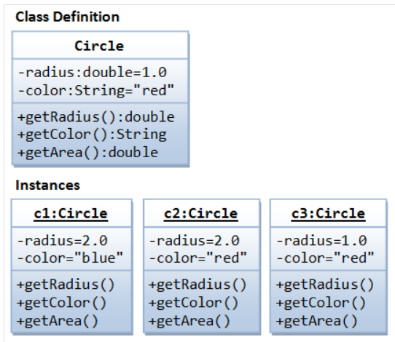
An OOP Example
A class called Circle is to be defined as illustrated in the class diagram.
It contains two data members: radius (of type double) and color (of type String); and three member functions: getRadius(), getColor(), and getArea().
Three instances of Circles called c1, c2, and c3 shall then be constructed with their respective data members, as shown in the instance diagrams.
In this example, we shall keep all the codes in a single source file called CircleAIO.cpp.

Slide 31
#include <iostream> #include <string> using namespace std;
class Circle {
private:
double radius; // Data member (Variable)
string color; // Data member (Variable)
public:
Circle(double r = 1.0, string c = "red") { // Constructor with default values for data members
radius = r;
color = c;
}
double getRadius() { // Member function (Getter)
return radius;
}
string getColor() { // Member function (Getter)
return color;
}
double getArea() { // Member function
return radius*radius*3.1416;}
}; // need to end the class declaration with a semi-colon

Slide 32
int main() {
// Construct a Circle instance, object
Circle c1(1.2, "blue");
cout << "Radius=" << c1.getRadius() << " Area=" << c1.getArea() << endl;
// Construct another Circle instance
Circle c2(3.4); // default color
cout << "Radius=" << c2.getRadius() << " Area=" << c2.getArea() << endl;
// Construct a Circle instance using default no-arg constructor
Circle c3; // default radius and color
cout << "Radius=" << c3.getRadius() << " Area=" << c3.getArea() << endl;
return 0;
}

Slide 33
Constructors
A constructor is a special function that has the function name same as the classname. In the above Circle class, we define a constructor as follows:
// Constructor has the same name as the class
Circle(double r = 1.0, string c = "red") {
radius = r;
color = c;
}
A constructor is used to construct and initialize all the data members.
A constructor in C++ is a special method that is automatically called when an object of a class is created.
To create a new instance of a class, you need to declare the name of the instance and invoke the constructor. For example,
Circle c1(1.2, "blue");
Circle c2(3.4); // default color
Circle c3; // default radius and color
// Take note that there is no empty bracket ()

Slide 34
class MyClass { // The class
public: // Access specifier
MyClass() { // Constructor
cout << "Hello World!";
}
};
int main() {
MyClass myObj; // Create an object of MyClass (this will call the constructor)
return 0;
}

Slide 35
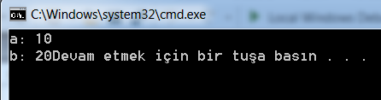
// Cpp program to illustrate the concept of Constructors
#include <iostream>
using namespace std;
class construct {
public:
int a, b;
construct() { // Default Constructor
a = 10;
b = 20;
}
};
int main() {
// Default constructor called automatically when the object is created
construct c;
cout << "a: " << c.a << endl
<< "b: " << c.b;
return 1;
}

Slide 36

// CPP program to illustrate parameterized constructors
#include <iostream> using namespace std;
class Point {
private:
int x, y;
public:
// Parameterized Constructor
Point(int x1, int y1) {
x = x1;
y = y1;
}
int getX() {
return x;
}
int getY() {
return y;
}
};
int main() {
// Constructor called
Point p1(10, 15);
// Access values assigned by constructor
cout << "p1.x = " << p1.getX() << ", p1.y = " << p1.getY();
return 0;
}

Slide 37
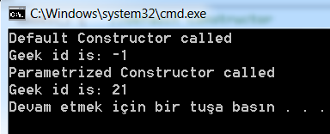
// C++ program to demonstrate constructors
#include <iostream>
using namespace std;
class Geeks {
public:
int id;
Geeks() { //Default Constructor
cout << "Default Constructor called" << endl;
id=-1;
}
//Parametrized Constructor
Geeks(int x)
{
cout << "Parametrized Constructor called" << endl;
id=x;
}
};
int main() {
// obj1 will call Default Constructor
Geeks obj1;
cout << "Geek id is: " <<obj1.id << endl;
// obj1 will call Parametrized Constructor
Geeks obj2(21);
cout << "Geek id is: " <<obj2.id << endl;
return 0;
}

Slide 38
class Car { // The class
public: // Access specifier
string brand; // Attribute
string model; // Attribute
int year; // Attribute
Car(string x, string y, int z) { // Constructor with parameters
brand = x;
model = y;
year = z;
}
};
int main() {
Car carObj1("BMW", "X5", 1999); // Create Car objects and call the constructor with different values
Car carObj2("Ford", "Mustang", 1969);
// Print values
cout << carObj1.brand << " " << carObj1.model << " " << carObj1.year << "\n";
cout << carObj2.brand << " " << carObj2.model << " " << carObj2.year << "\n";
return 0;
}

Slide 39
Just like functions, constructors can also be defined outside the class.
class Car { // The class
public: // Access specifier
string brand; // Attribute string model; // Attribute int year; // Attribute
Car(string x, string y, int z); // Constructor declaration
};
Car::Car(string x, string y, int z) { // Constructor definition outside the class
brand = x;
model = y;
year = z;
}
int main() {
Car carObj1("BMW", "X5", 1999); // Create Car objects and call the constructor with different values
Car carObj2("Ford", "Mustang", 1969);
// Print values
cout << carObj1.brand << " " << carObj1.model << " " << carObj1.year << "\n";
cout << carObj2.brand << " " << carObj2.model << " " << carObj2.year << "\n";
return 0;
}

Slide 40
A constructor function is different from an ordinary function in the following aspects:
The name of the constructor is the same as the classname.
Constructor has no return type (or implicitly returns void). Hence, no return statement is allowed inside the constructor's body.
Constructor can only be invoked once to initialize the instance constructed.
You cannot call the constructor afterwards in your program.
Constructors are not inherited (to be explained later).

Slide 41
A destructor is a special member function that works just opposite to constructor. Unlike constructors that are used for initializing an object, destructors destroy (or delete) the object. When does the destructor get called? A destructor is automatically called when: 1) The program finished execution. 2) When a scope (the { } parenthesis) containing local variable ends. 3) When you call the delete operator.
#include <iostream>
using namespace std;
class HelloWorld{
public:
HelloWorld(){ //Constructor
cout<<"Constructor is called"<<endl;
}
~HelloWorld(){ //Destructor
cout<<"Destructor is called"<<endl;
}
void display(){//Member function
cout<<"Hello World!"<<endl;
}
};
int main(){
HelloWorld obj; //Object created
obj.display(); //Member function called
return 0;
}

Slide 42
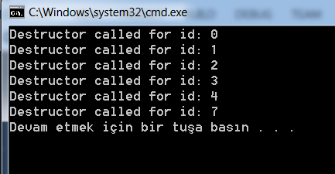
Destructor is another special member function that is called by the compiler when the scope of the object ends.
#include <iostream> using namespace std;
class Geeks {
public:
int id;
~Geeks() { //Definition for Destructor
cout << "Destructor called for id: " << id <<endl;
}
};
int main() {
Geeks obj1;
obj1.id=7;
int i = 0;
while ( i < 5 ) {
Geeks obj2;
obj2.id=i;
i++;
} // Scope for obj2 ends here
return 0;
} // Scope for obj1 ends here
Destructors

Slide 43
Default Arguments for Functions
In C++, you can specify the default value for the trailing arguments of a function (including constructor) in the function header. For example,
#include <iostream> /* Test function default arguments */
using namespace std;
// Function prototype
int sum(int n1, int n2, int n3 = 0, int n4 = 0, int n5 = 0);
int main() {
cout << sum(1, 1, 1, 1, 1) << endl; // 5
cout << sum(1, 1, 1, 1) << endl; // 4
cout << sum(1, 1, 1) << endl; // 3
cout << sum(1, 1) << endl; // 2
// cout << sum(1) << endl; // error: too few arguments
}
// Function definition// The default values shall be specified in function prototype,
// not the function implementation
int sum(int n1, int n2, int n3, int n4, int n5) {
return n1 + n2 + n3 + n4 + n5;
}

Slide 44
Access Specifiers
In C++, there are three access specifiers:
public - members are accessible from outside the class
private - members cannot be accessed (or viewed) from outside the class
protected - members cannot be accessed from outside the class, however, they can be accessed in inherited classes. You will learn more about Inheritance later.
class MyClass { // The class
public: // Access specifier
// class members goes here
};

Slide 45
class MyClass {
public: // Public access specifier
int x; // Public attribute
private: // Private access specifier
int y; // Private attribute
};
int main() {
MyClass myObj;
myObj.x = 25; // Allowed (public)
myObj.y = 50; // Not allowed (private)
return 0;
}

Slide 46
"public" vs. "private" Access Control Modifiers
An access control modifier can be used to control the visibility of a data member or a member function within a class. We begin with the following two access control modifiers:
public: The member (data or function) is accessible and available to all in the system.
private: The member (data or function) is accessible and available within this class only.
For example, in the above Circle definition, the data member radius is declared private. As the result, radius is accessible inside the Circle class, but NOT outside the class.
In other words, you cannot use "c1.radius" to refer to c1's radius in main().
The function getRadius() is declared public in the Circle class. Hence, it can be invoked in the main().
UML Notation: In UML notation, public members are denoted with a "+", while private members with a "-" in the class diagram.

Slide 47
By default, all members of a class are private if you don't specify an access specifier:
class MyClass {
int x; // Private attribute
int y; // Private attribute
};

Slide 48
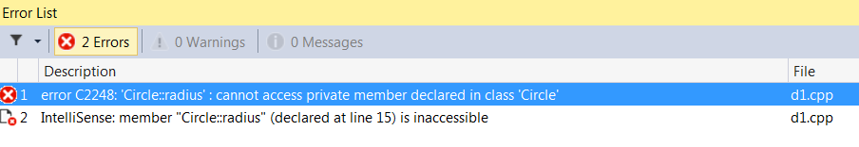
// C++ program to demonstrate private access modifier
#include<iostream>
using namespace std;
class Circle {
// private data member
private:
double radius;
// public member function
public:
double compute_area()
{ // member function can access private
// data member radius
return 3.14*radius*radius;
}
};
int main()
{
// creating object of the class
Circle obj;
// trying to access private data member
// directly outside the class
obj.radius = 1.5;
cout << "Area is:" << obj.compute_area();
return 0;
}

Slide 49

/ C++ program to demonstrate private access modifier
#include<iostream>
using namespace std;
class Circle {
private: // private data member
double radius;
public: // public member function
void compute_area(double r)
{ // member function can access private
// data member radius
radius = r;
double area = 3.14*radius*radius;
cout << "Radius is: " << radius << endl;
cout << "Area is: " << area;
}
};
int main()
{
// creating object of the class
Circle obj;
// trying to access private data member
// directly outside the class
obj.compute_area(1.5);
return 0;
}

Slide 50
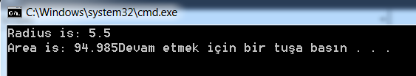
// C++ program to demonstrate public access modifier
#include<iostream>
using namespace std;
class Circle { // class definition
public:
double radius;
double compute_area() {
return 3.14*radius*radius;
}
};
int main() {
Circle obj;
obj.radius = 5.5; // accessing public datamember outside class
cout << "Radius is: " << obj.radius << "\n";
cout << "Area is: " << obj.compute_area();
return 0;
}

Slide 51
Information Hiding and Encapsulation
A class encapsulates the static attributes and the dynamic behaviors into a "3-compartment box".
Once a class is defined, you can seal up the "box" and put the "box" on the shelve for others to use and reuse.
Data member of a class are typically hidden from the outside word, with private access control modifier.
This follows the principle of information hiding.
That is, objects communicate with each others using well-defined interfaces (public functions).
Objects are not allowed to know the implementation details of others. The implementation details are hidden or encapsulated within the class. Information hiding facilitates reuse of the class.
Rule of Thumb: Do not make any data member public, unless you have a good reason.

Slide 52
Getters and Setters
To allow others to read the value of a private data member says xxx, you shall provide a get function (or getter or accessor function) called getXxx().
It can process the data and limit the view of the data others will see. Getters shall not modify the data member.
To allow other classes to modify the value of a private data member says xxx, you shall provide a set function (or setter or mutator function) called setXxx().
A setter could provide data validation (such as range checking), and transform the raw data into the internal representation.

Slide 53
#include <iostream> #include <string> using namespace std;
class Circle {
private: double radius; // Data member (Variable) string color; // Data member (Variable)
public:
Circle(double r = 1.0, string c = "red") { // Constructor with default values for data members
radius = r;
color = c;
}
double getRadius() { // Member function (Getter)
return radius;
}
string getColor() { // Member function (Getter)
return color;
}
double getArea() { // Member function
return radius*radius*3.1416;}
}; // need to end the class declaration with a semi-colon

Slide 54
For example, in our Circle class:
The data members radius and color are declared private.
That is to say, they are only available within the Circle class and not visible outside the Circle class - including main().
You cannot access the private data members radius and color from the main() directly - via says c1.radius or c1.color.
The Circle class provides two public accessor functions, namely, getRadius() and getColor(). These functions are declared public.
The main() can invoke these public accessor functions to retrieve the radius and color of a Circle object, via says c1.getRadius() and c1.getColor().
There is no way you can change the radius or color of a Circle object, after it is constructed in main().
You cannot issue statements such as c1.radius = 5.0 to change the radius of instance c1, as radius is declared as private in the Circle class and is not visible to other including main().
If the designer of the Circle class permits the change the radius and color after a Circle object is constructed, he has to provide the appropriate setter, e.g.,

Slide 55
// Setter for color
void setColor(string c) {
color = c;
}
// Setter for radius
void setRadius(double r) {
radius = r;
}

Slide 56
#include<iostream> // c++ program to explain Encapsulation
using namespace std;
class Encapsulation {
private:
int x; // data hidden from outside world
public:
void set(int a) { // function to set value of // variable x
x =a;
}
int get() { // function to return value of // variable x
return x;
}
};
int main() {
Encapsulation obj;
obj.set(5);
cout<<obj.get();
return 0;
}

Slide 57
#include <iostream>
using namespace std;
class Employee {
private:
int salary; // Private attribute
public:
void setSalary(int s) { // Setter
salary = s;
}
int getSalary() { // Getter
return salary;
}
};
int main() {
Employee myObj;
myObj.setSalary(50000);
cout << myObj.getSalary();
return 0;
}

Slide 58
Keyword "this"
One of the main usage of keyword this is to resolve ambiguity between the names of data member and function parameter.
class Circle {
private:
double radius; // Member variable called "radius"
......
public:
void setRadius(double radius) { // Function's argument also called "radius"
this->radius = radius;
// "this.radius" refers to this instance's member variable // "radius" resolved to the function's argument.
}
......
}
In the above codes, there are two identifiers called radius - a data member and the function parameter.
This causes naming conflict. To resolve the naming conflict, you could name the function parameter r instead of radius.
However, radius is more approximate and meaningful in this context.
You can use keyword this to resolve this naming conflict. "this->radius" refers to the data member; while "radius" resolves to the function parameter.
"this" is actually a pointer to this object.

Slide 59
Alternatively, you could use a prefix (such as m_) or suffix (such as _) to name the data members to avoid name crashes. For example,
class Circle {
private:
double m_radius; // or radius_
......
public:
void setRadius(double radius) {
m_radius = radius; // or radius_ = radius
}
......
}

Slide 60
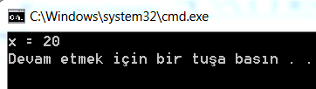
#include<iostream>
using namespace std;
/* local variable is same as a member's name */
class Test
{
private:
int x;
public:
void setX (int x)
{
// The 'this' pointer is used to retrieve the object's x
// hidden by the local variable 'x'
this->x = x;
}
void print() { cout << "x = " << x << endl; }
};
int main()
{
Test obj;
int x = 20;
obj.setX(x);
obj.print();
return 0;
}

Slide 61
#include <iostream>
using namespace std;
class Box {
public: // Constructor definition
Box(double l = 2.0, double b = 2.0, double h = 2.0) {
cout << "Constructor called." << endl;
length = l;
breadth = b;
height = h;
}
double Volume() {
return length * breadth * height;
}
int compare(Box box) {
return this->Volume() > box.Volume();
}
private:
double length; // Length of a box
double breadth; // Breadth of a box
double height; // Height of a box
};
int main(void) {
Box Box1(3.3, 1.2, 1.5);//Declarebox1
Box Box2(8.5, 6.0, 2.0);//Declarebox2
if (Box1.compare(Box2)) {
cout << "Box2 is smaller than Box1" << endl;
}
else {
cout << "Box2 is equal to or larger than Box1" << endl;
}
return 0;}

Slide 62
"const" Member Functions
A const member function, identified by a const keyword at the end of the member function's header, cannot modifies any data member of this object. For example,
double getRadius() const { // const member function
radius = 0;
// error: assignment of data-member 'Circle::radius' in read-only structure
return radius;
}

